Slide 1
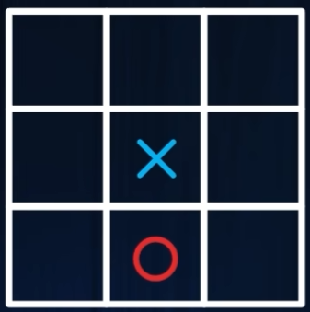
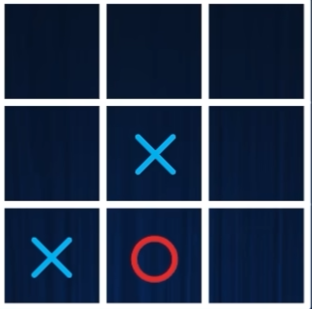
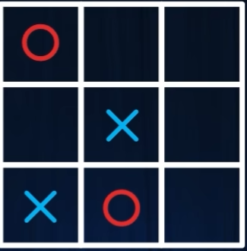
State
Outcome
State
Outcome
State
Outcome

Slide 2
How about AlphaGo?
Tic-Tac-Toe’s state space= 3^9 ≈ 20000
Go’s state space= 3^(19x19) ≈10^170 The number of atoms in the universe= 10^70 It’s not possible to use matrix to saving all states,,,

Slide 3
Learning patterns, not ALL states
If we use Deep Learning, it will be: Encoding the board as a tensor of shape 19×19×3(Input and Output)
The Policy Network predicts which move to play next (a probability over all 361 points), while the Value Network estimates the overall win probability of the current board.
Lastly, using RL.

